Slide 1
Image processing
Sandeep PVN 01FB14ECS207
S Varun 01FB14ECS196 SK Mayank 01FB14ECS194
Rishabh Soni 01FB14ECS189

Slide 2
ABSTRACT
Image processing is processing of images using mathematical operations by using any form of signal processing for which the input is an image, a series of images, or a video, such as a photograph or video frame.
Since our topic is named image processing by machine learning we have taken the numerous images of apple and banana. So how do you identify them? We are given 10 images of apples and bananas.
Each reference image obtained represents a 3X1 matrix and can be denoted as a vector.
Take another image for testing and find the error with reference to the derived reference image. The error E is the vectorial difference of the test image vector and the given reference image vector.

Slide 3
CONCEPTS USED
Scaling
Errors
Transposing matrix
Nom representation with matrices.

Slide 4
FORMULAS USED
MEAN = ∑ of all variables (Sum)
Number of variables
|| B – A|| = sqrroot ( | | B | |^2 + | | A | |^2 – 2 * B’.A )
Cosθ == __ B’. A_____
||B|| ||A||
A.A’ = | | A | | ^2

Slide 5
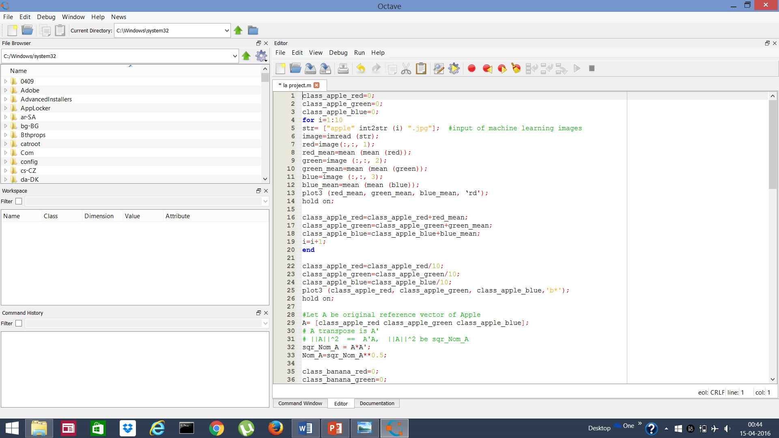
CODE

Slide 6
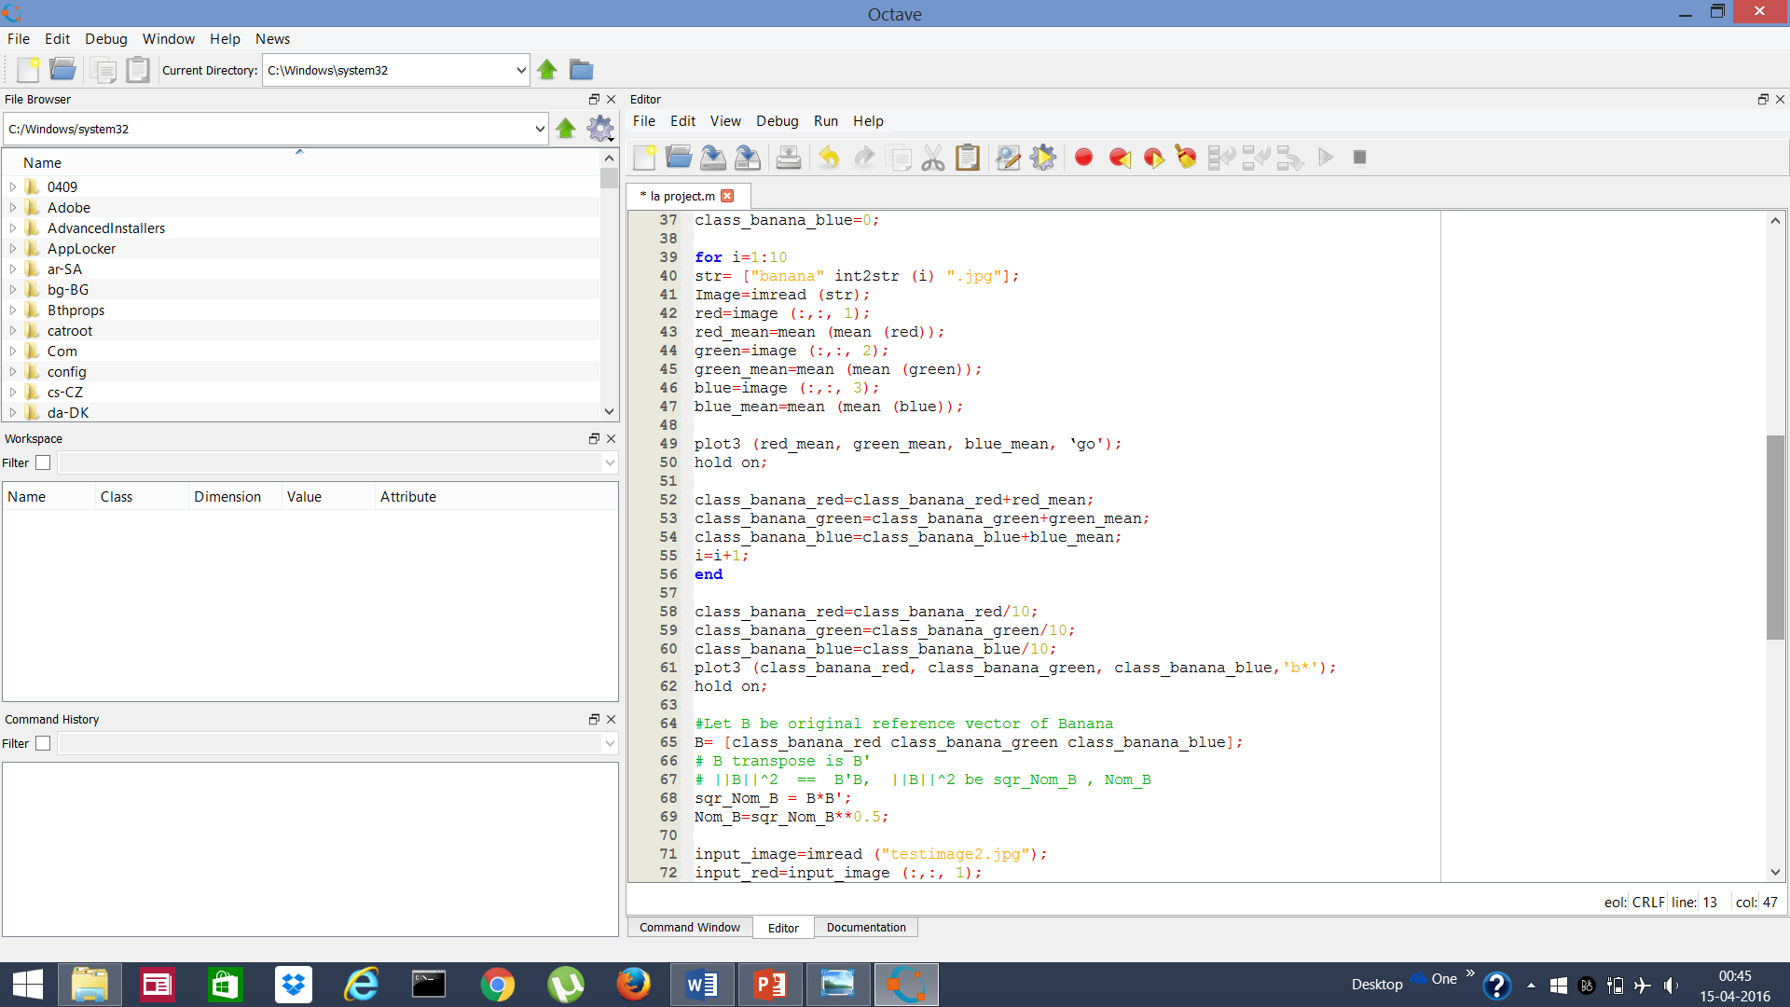

Slide 7
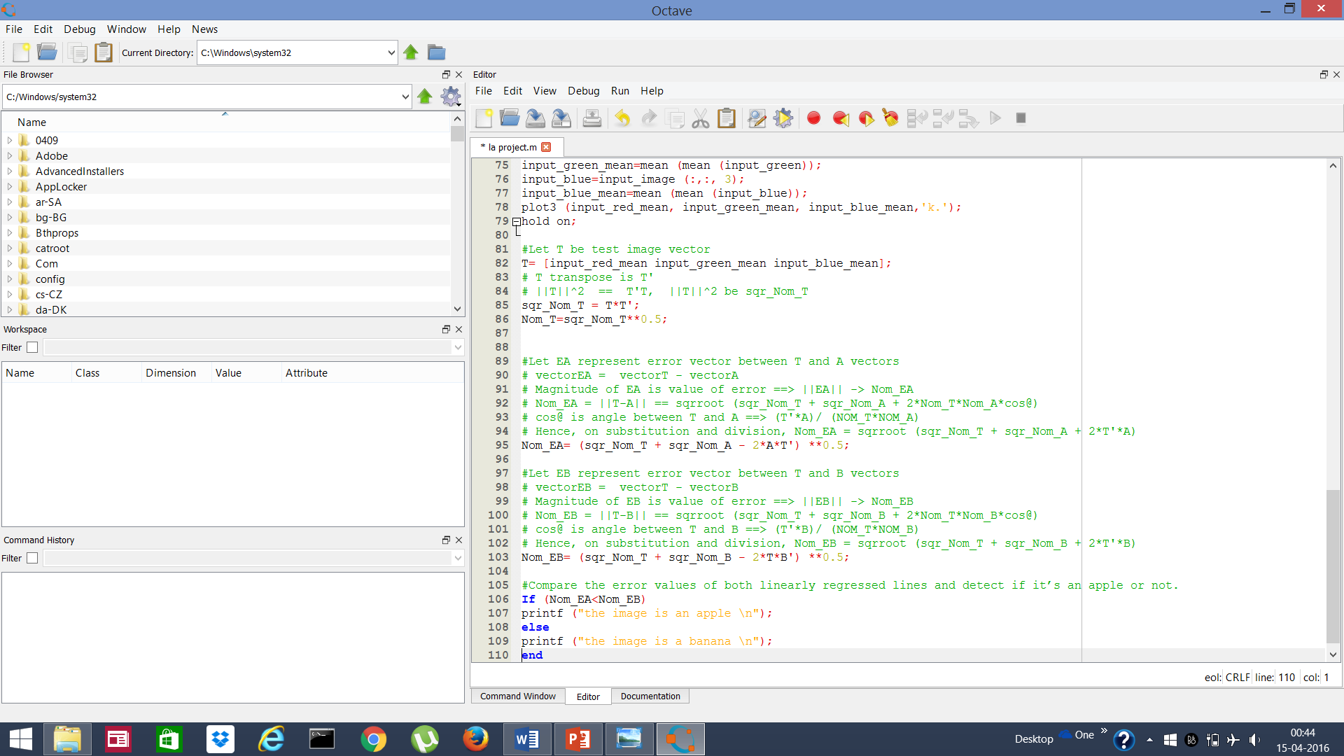

Slide 8
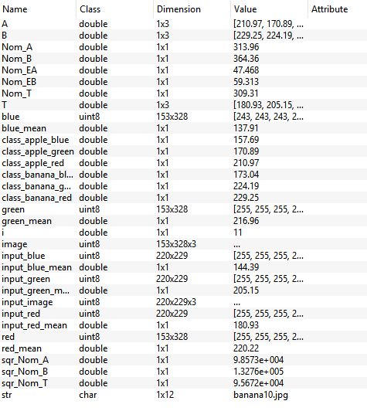
Table Of Variables

Slide 9
THANKYOU

